Slide 1



Slide 2
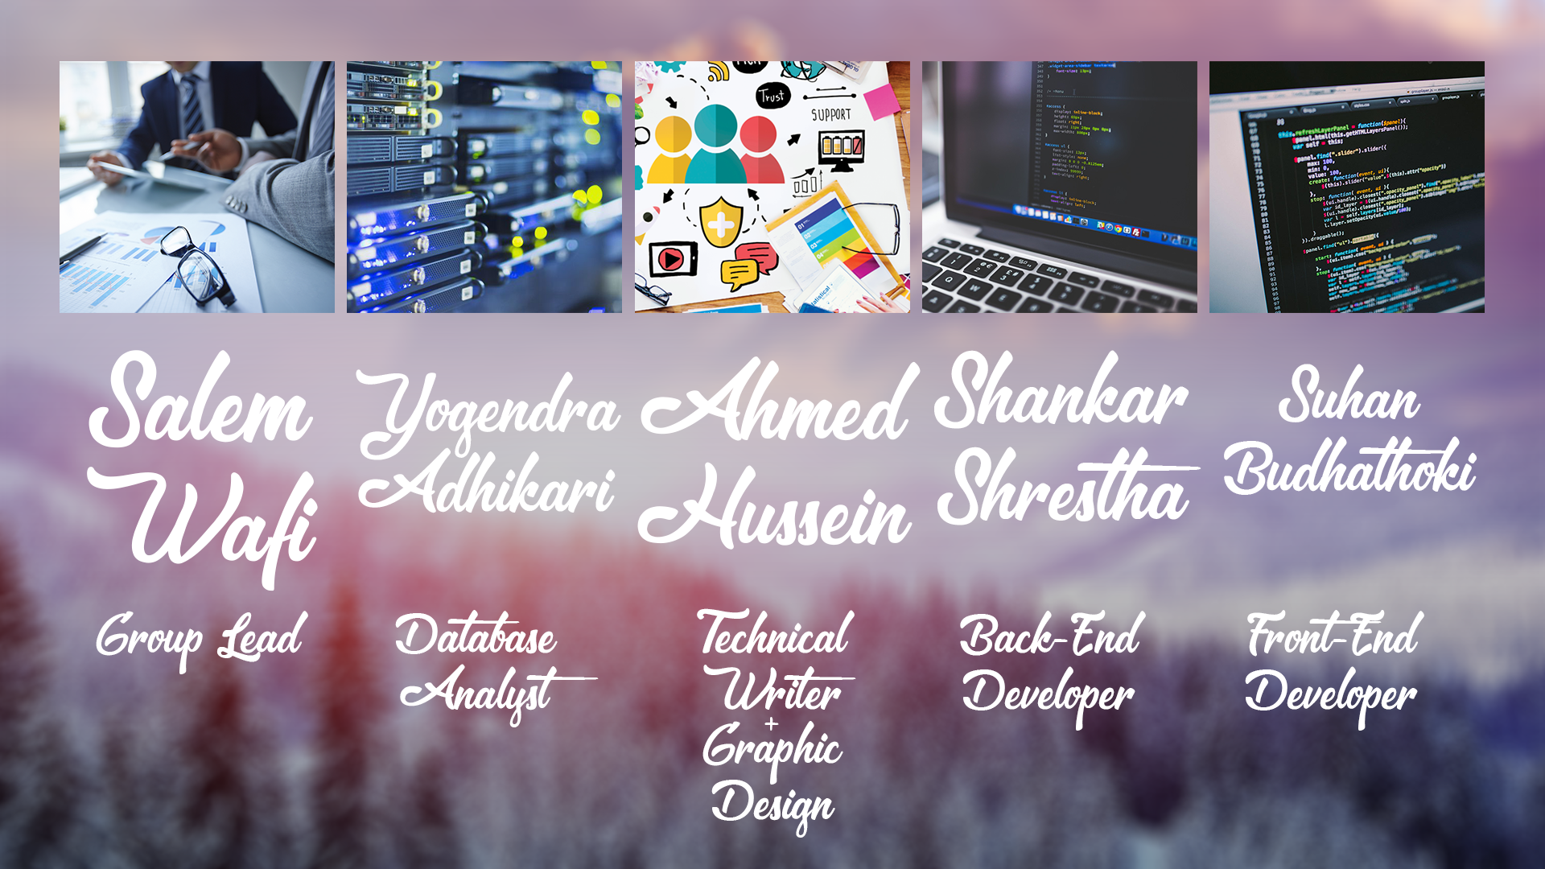


Slide 3


Supporting the critical relationship between the MR and our customer by using the CRM system. The CRM system will be the MRs primary system they use on a daily basis to keep tracking their customers records more efficiently.

Slide 4

User Group Structure
Type of Clients
Data needed from clients
Expected Features
Mobile Friendly
Easy generation of reports

Slide 5

Build a Dashboard.
Build a foundation for the master customer record.
Have the ability in the system to categorize your customers.
Build a functionality in the system to allow the MRs, DMMs, RMMs to generate different reports such as Financial analysis report, and Client statistic report.
Notifications (birthday, meeting, task)

Slide 6

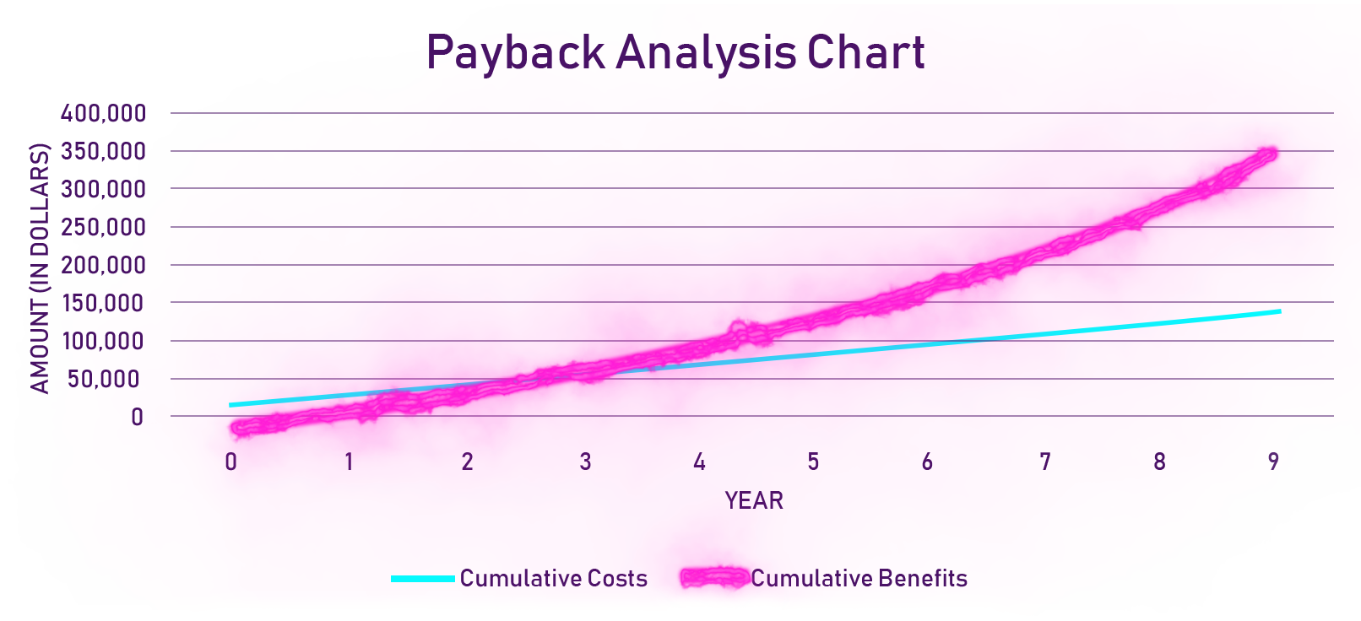

Slide 7
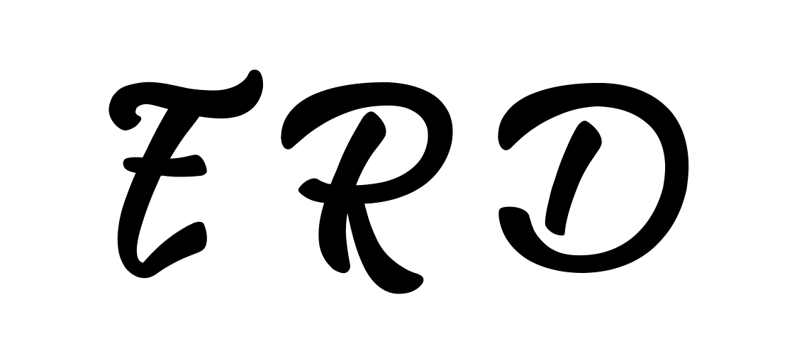
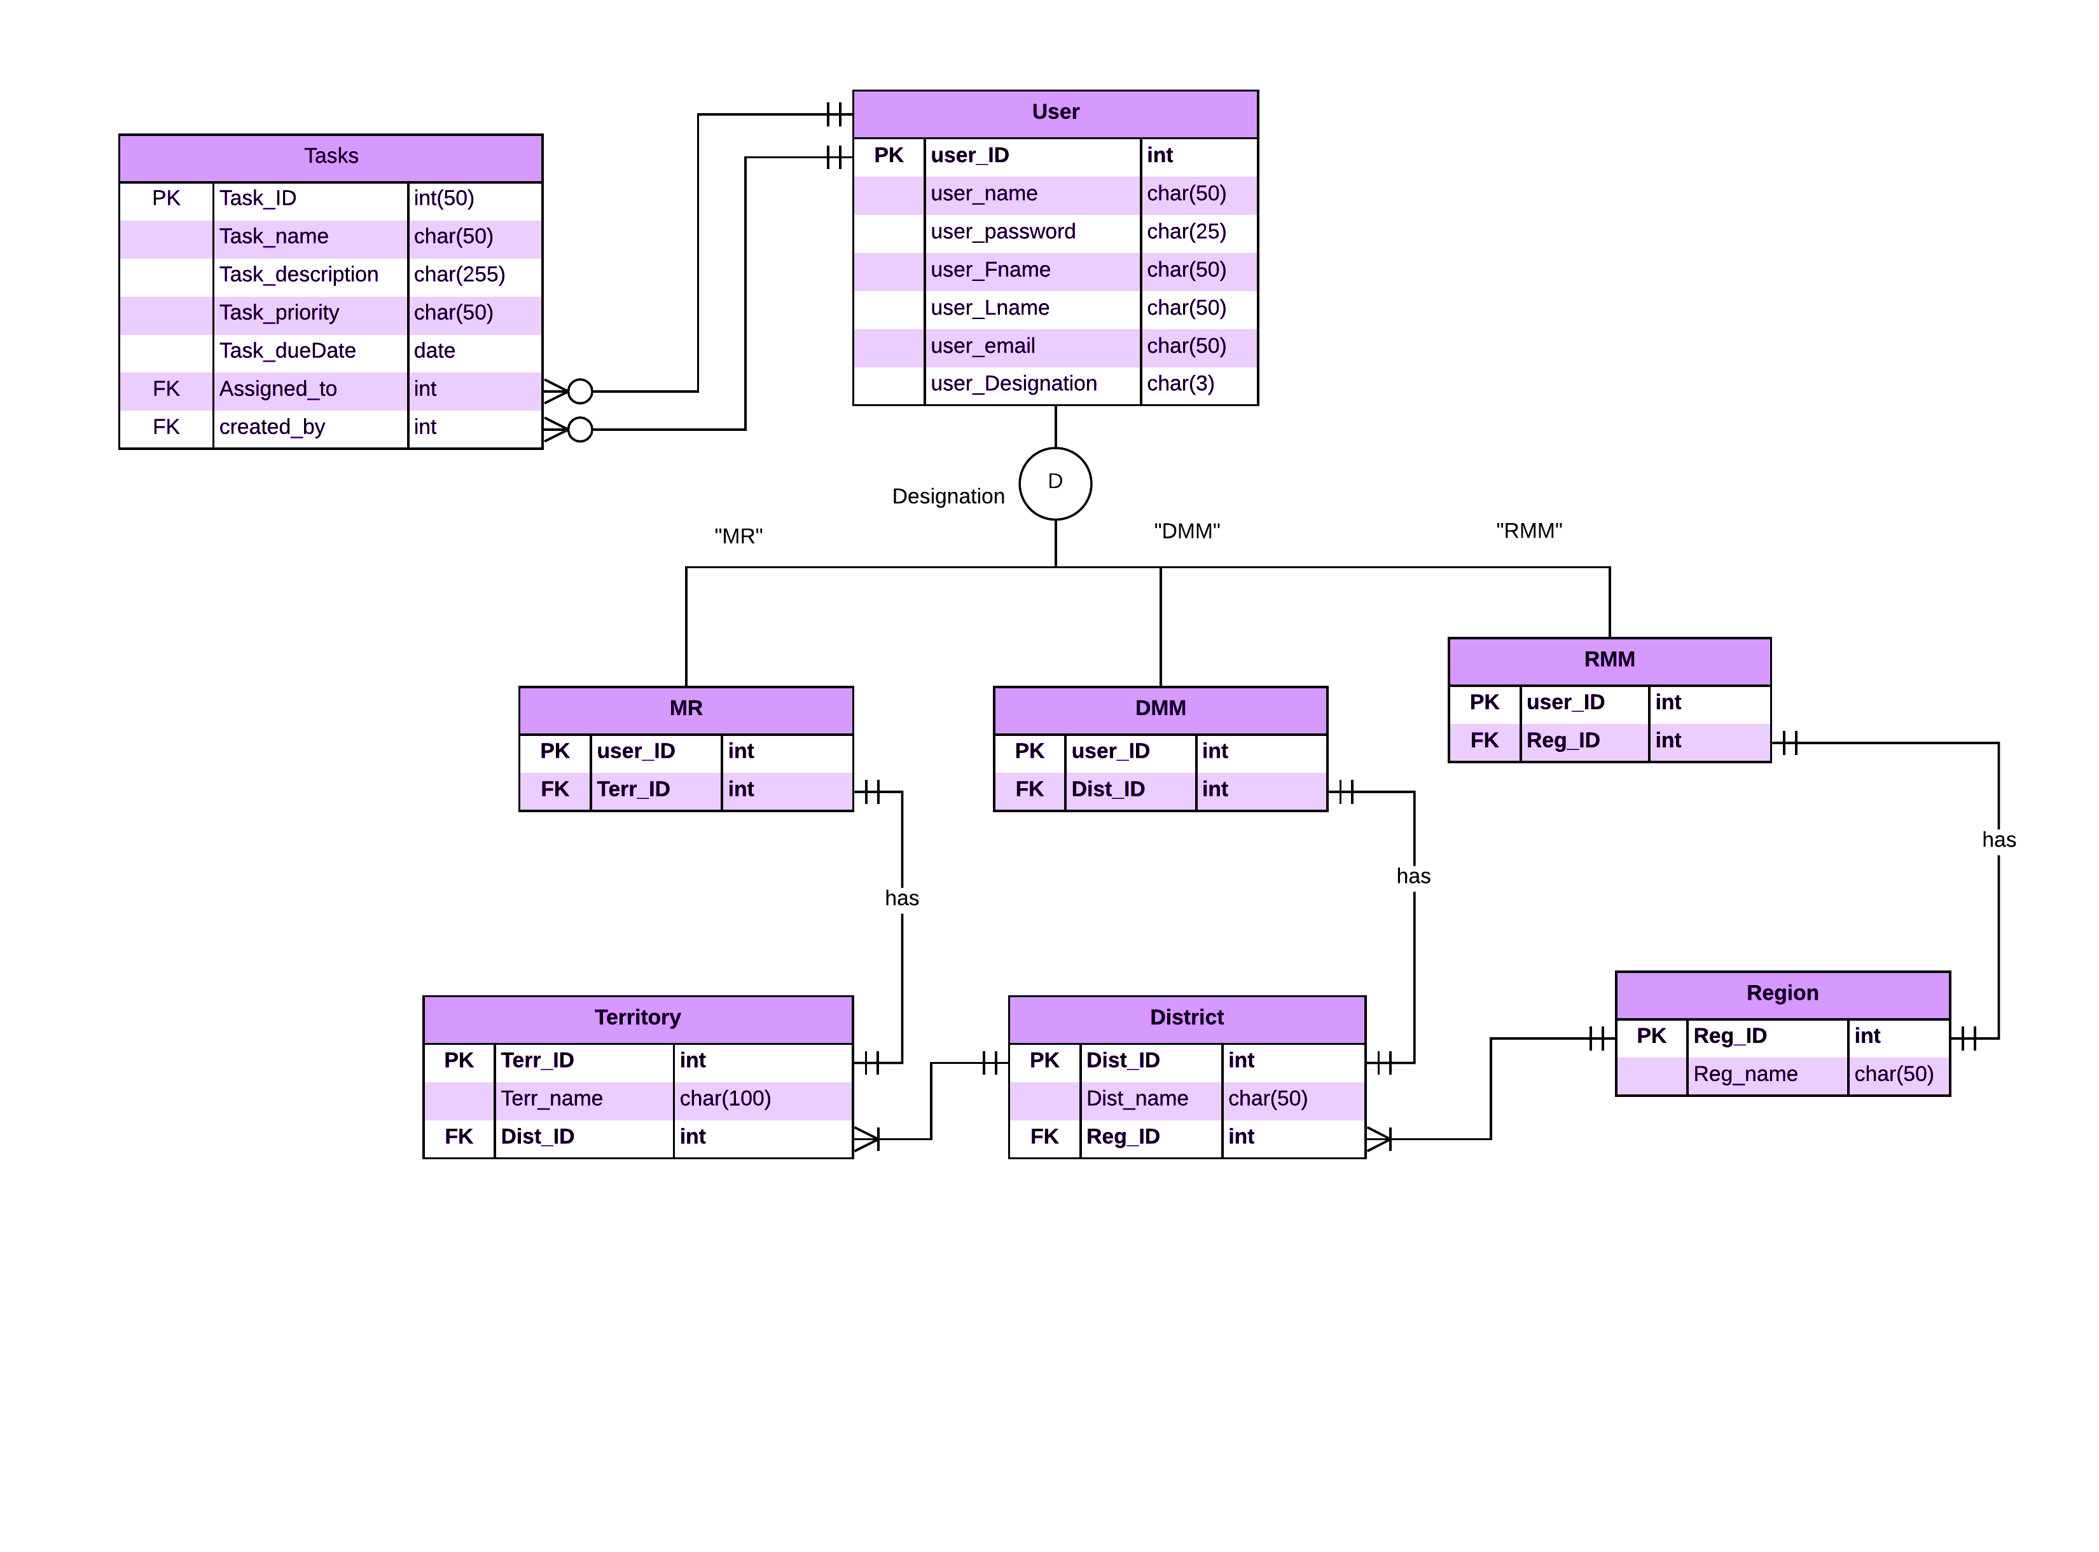
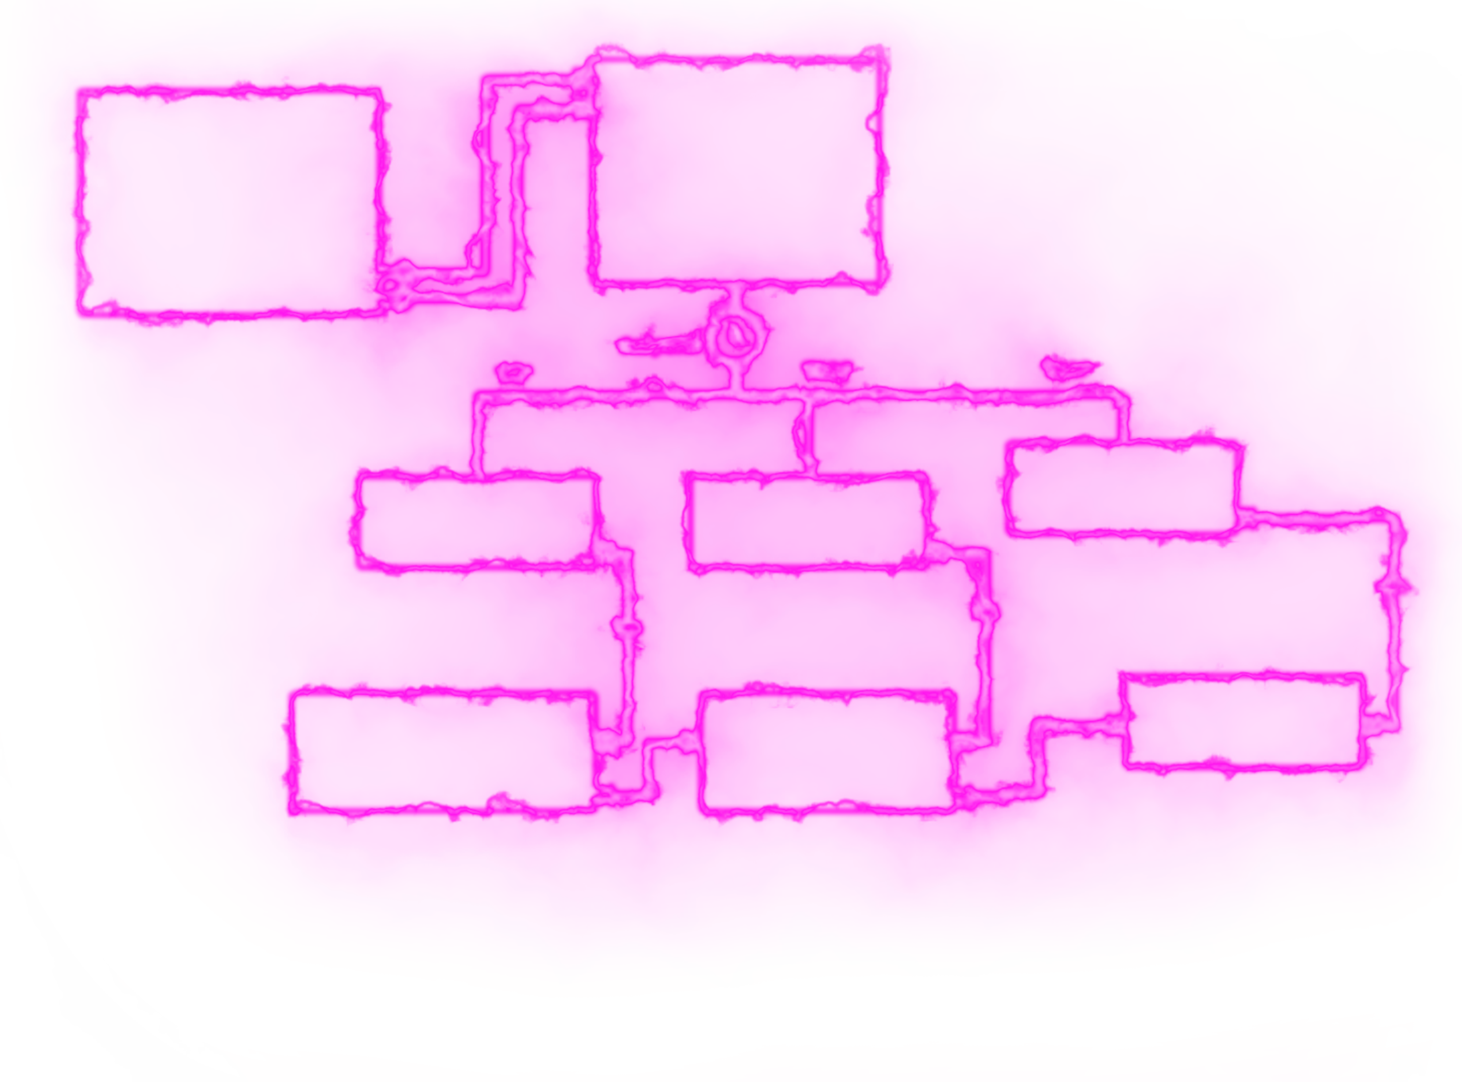
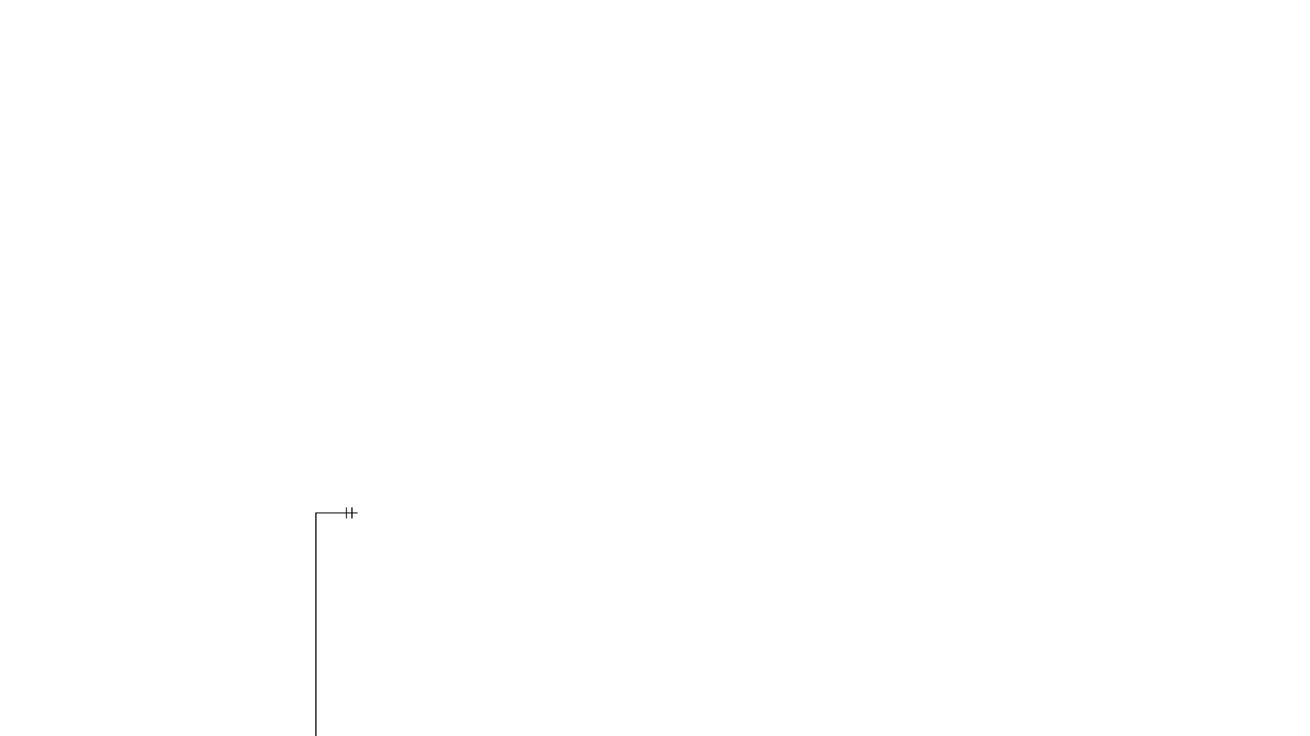

Slide 8
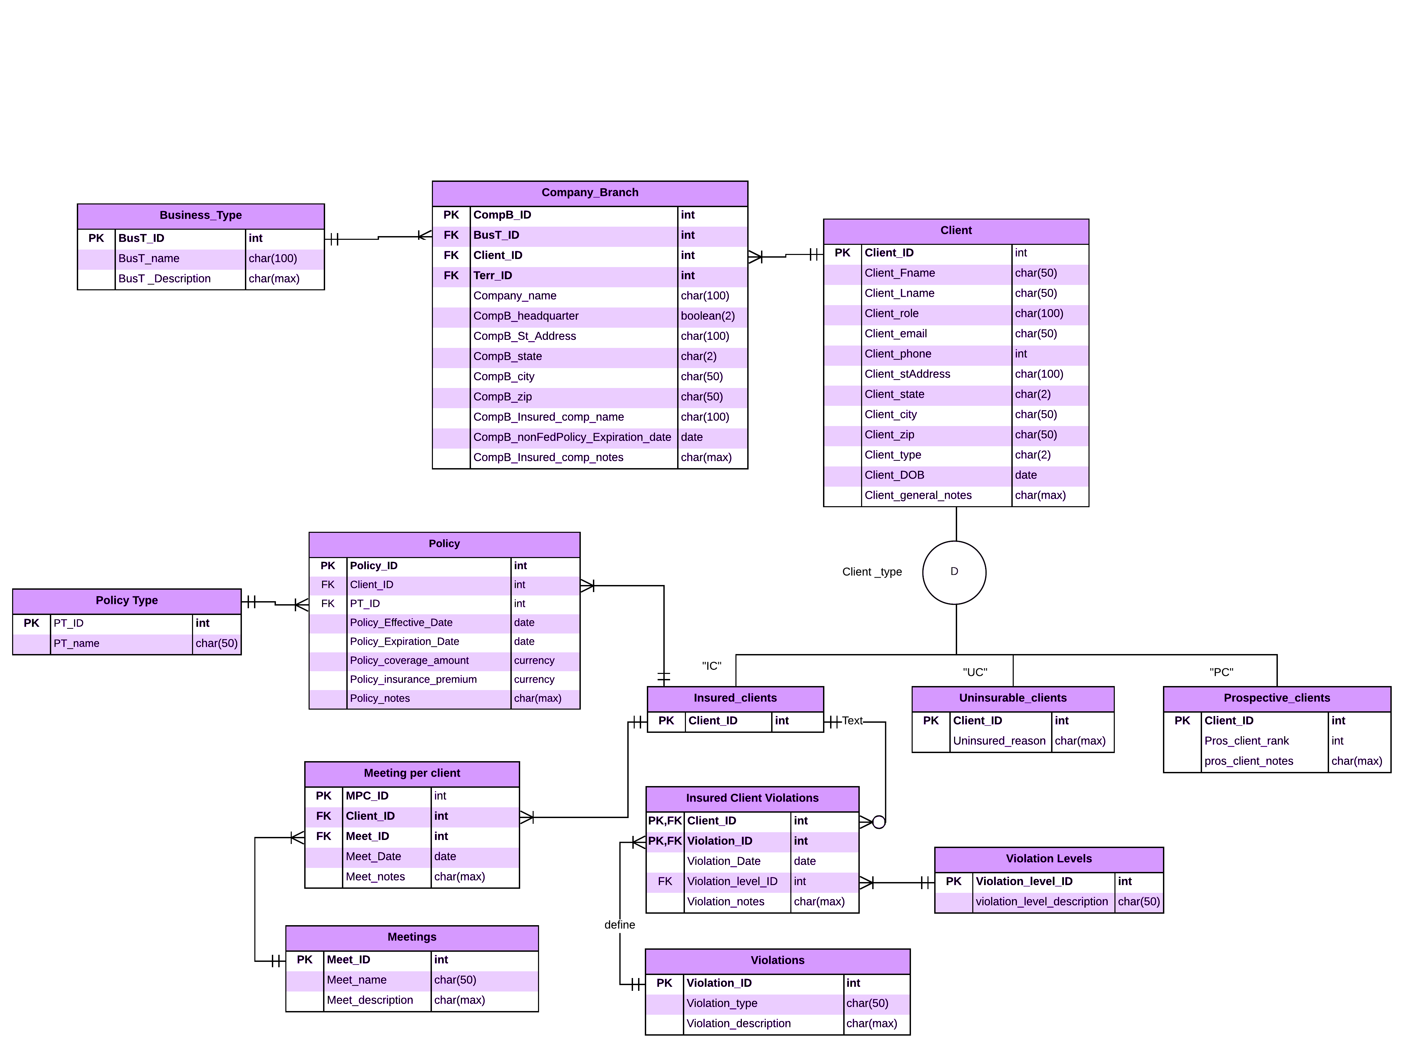
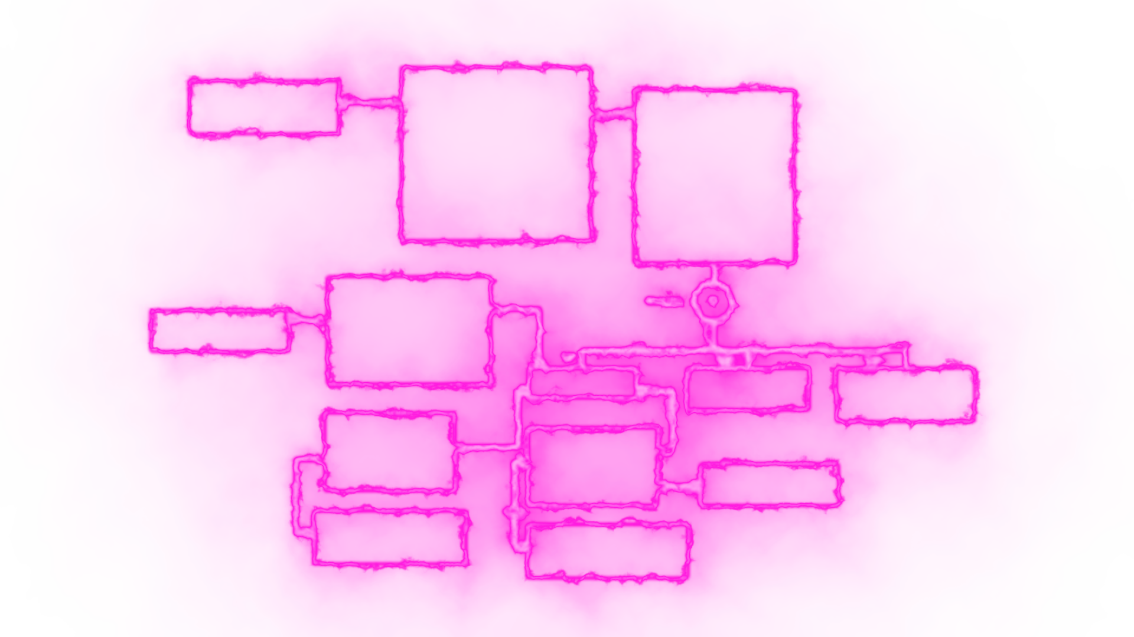
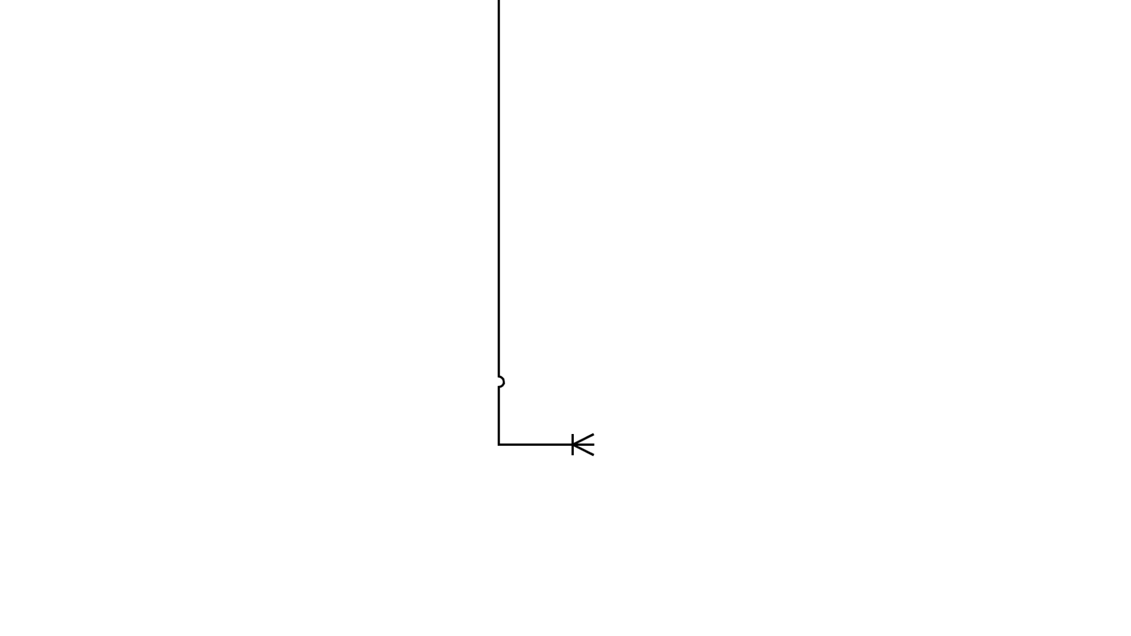

Slide 9
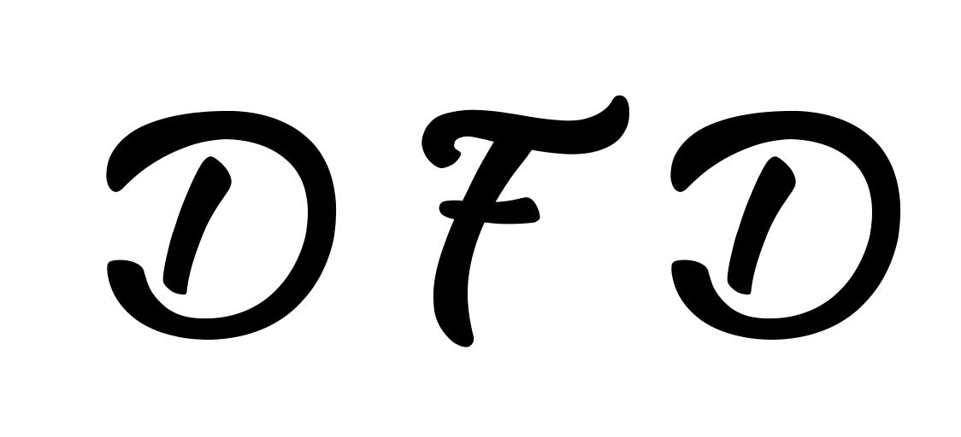
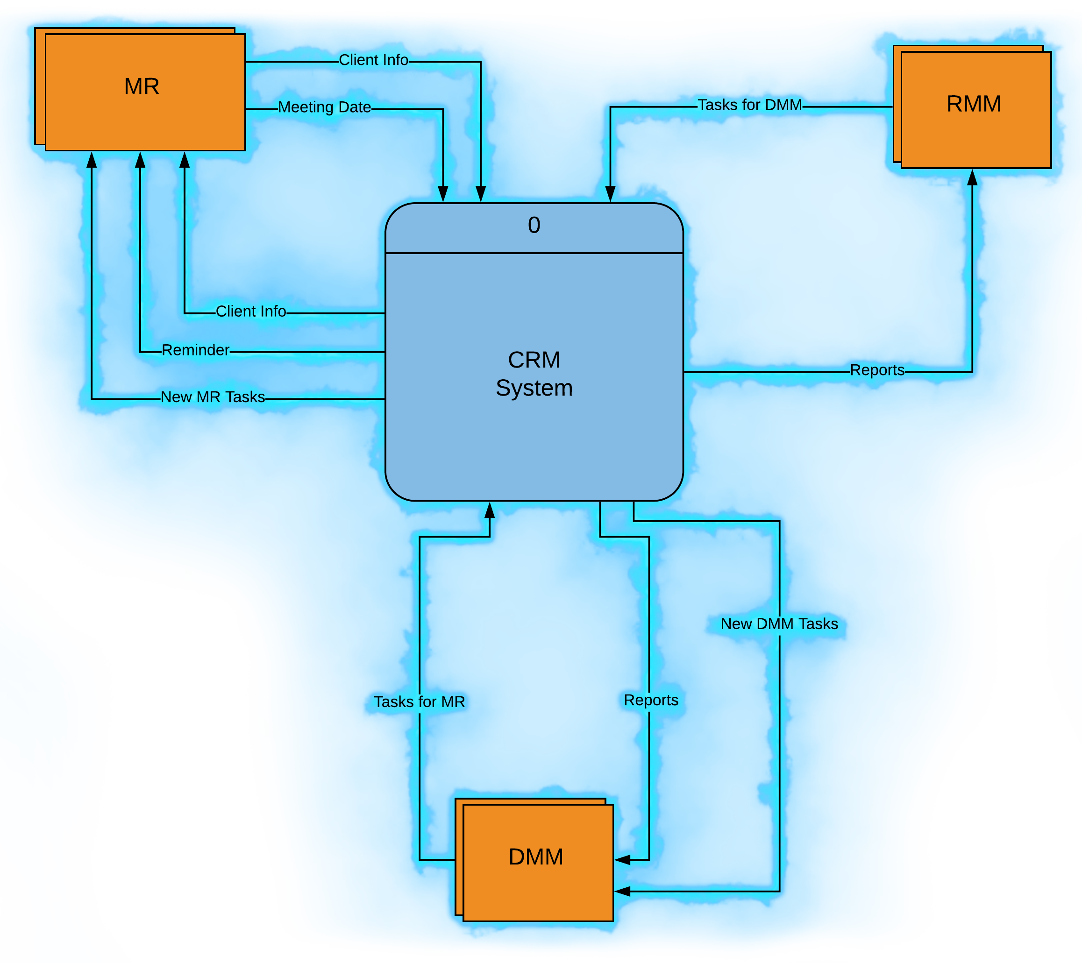

Slide 10
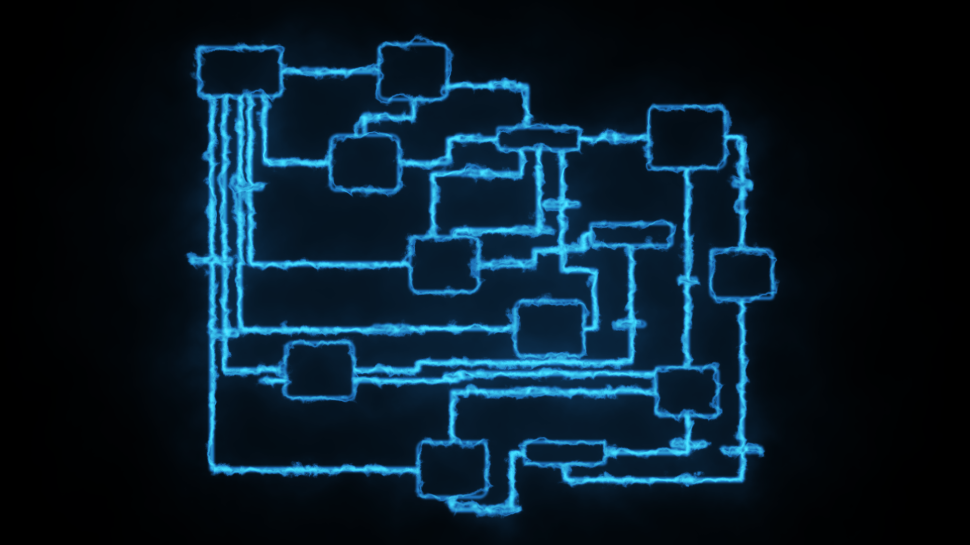
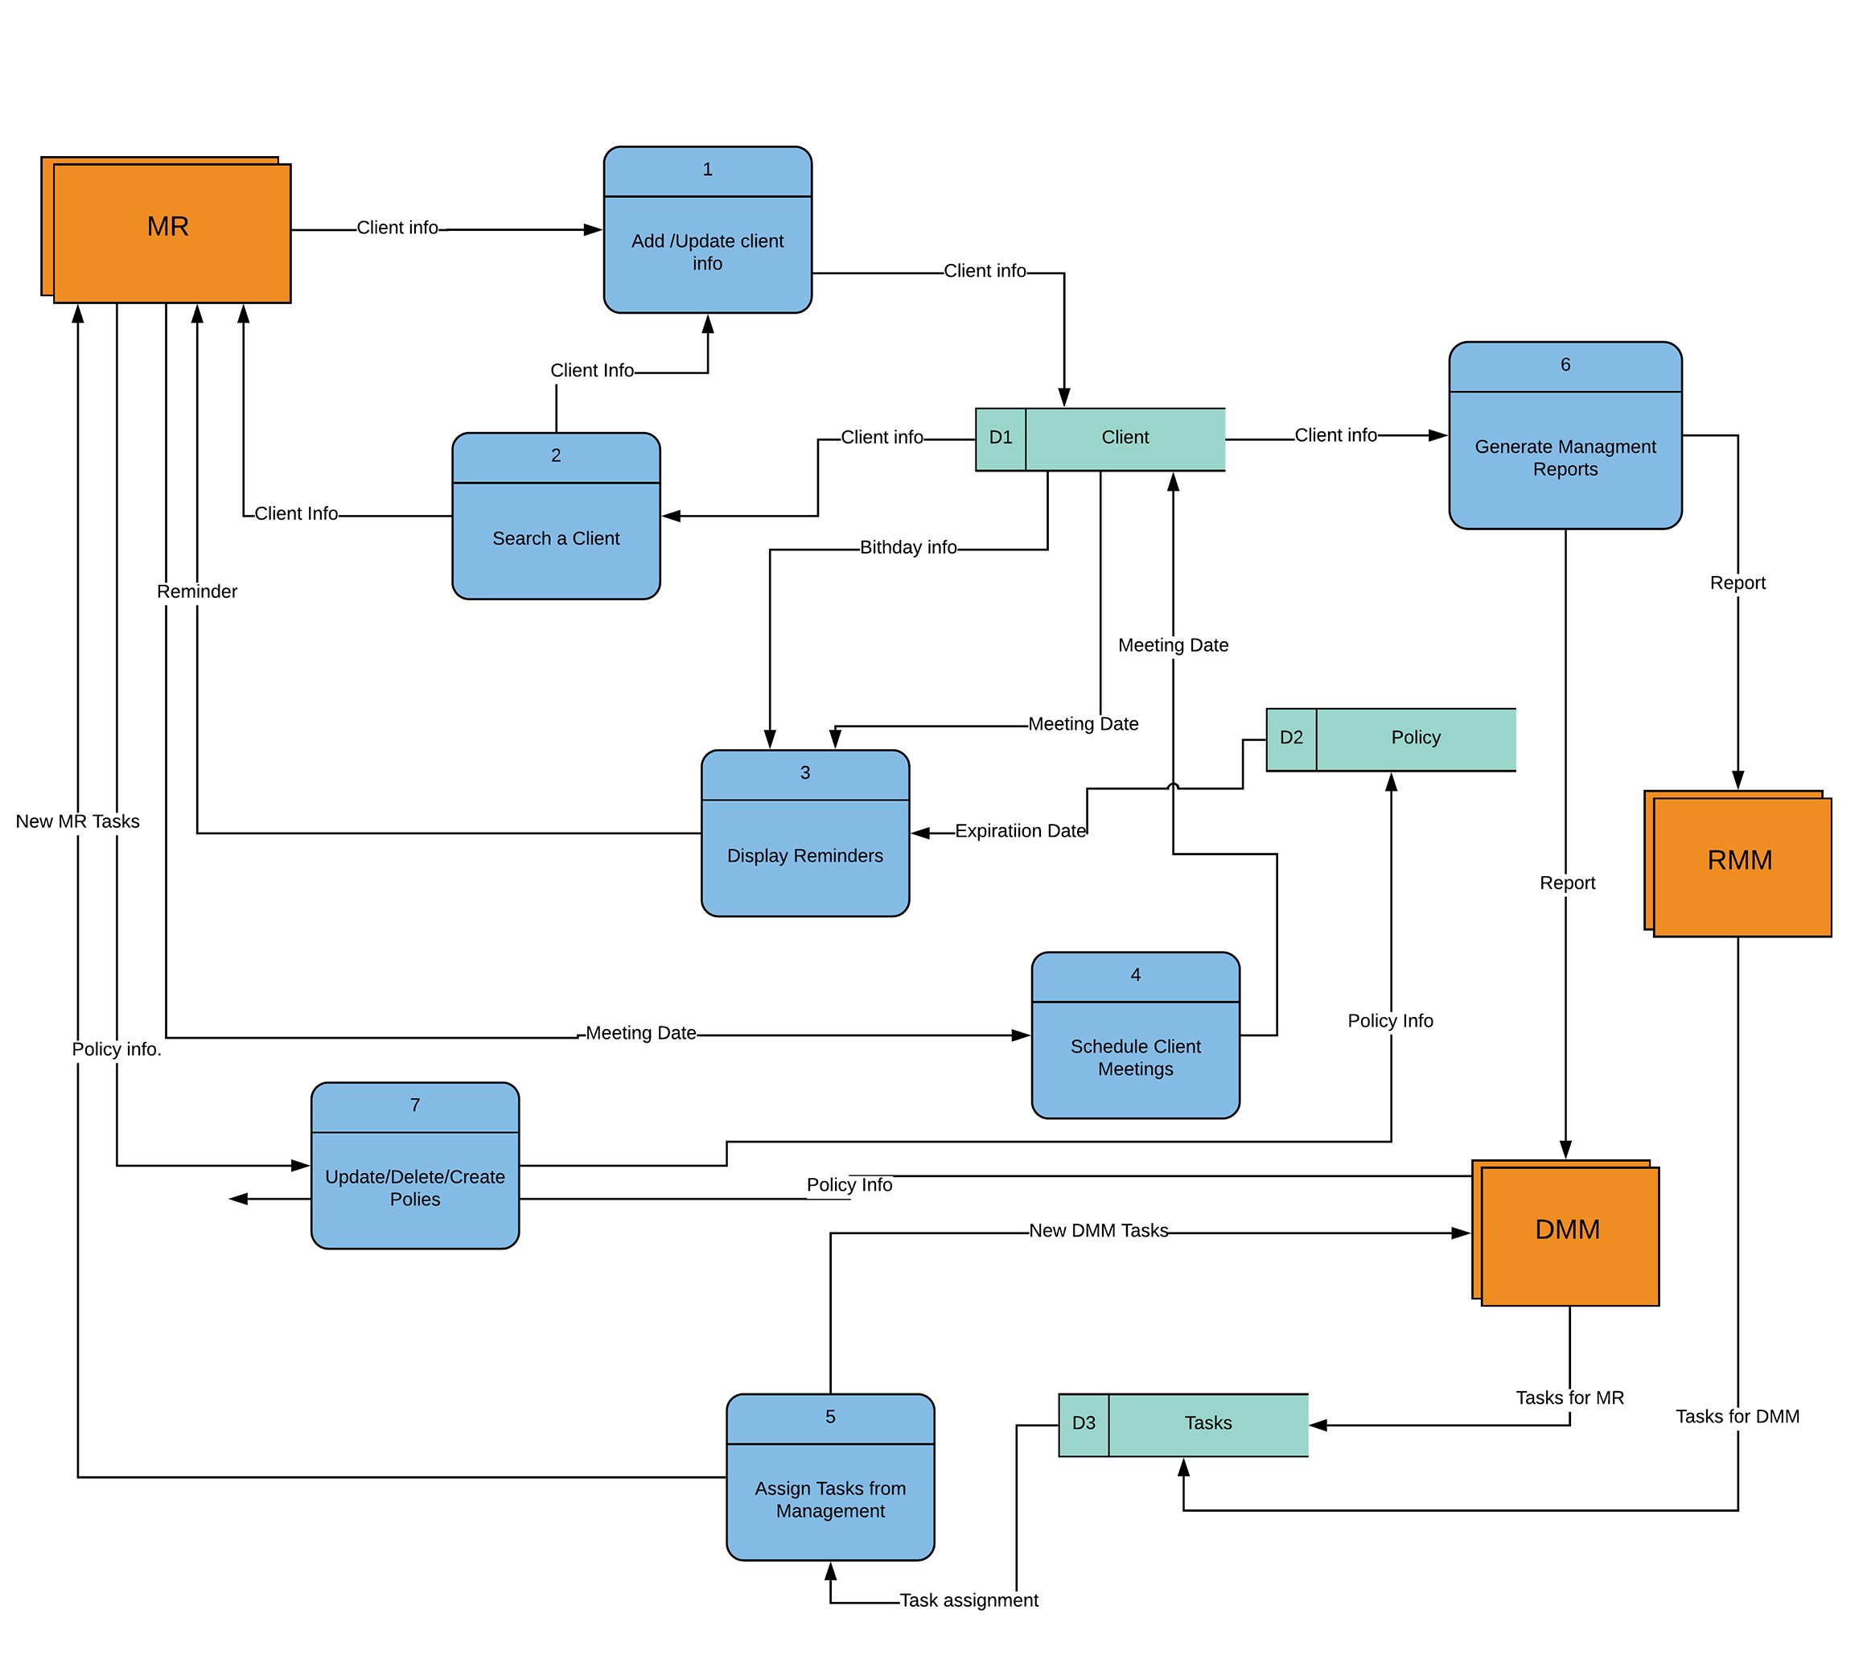

Slide 11




Slide 12



